Slide 1
Central and West Integration Network
Knowledge into Action – Community-led research that makes a difference

Slide 2
About CWIN
The Central and West Integration Network works
to support asylum seekers, refugees, black and minority ethnic communities and migrant workers across Glasgow
promote integration with these communities. We wo
alleviate poverty and improve their standard of living
promote their settlement and integration within the wider community.
help destitute individuals and families in times of crisis and hardship where they may often have no other support available.
We are based at the Garnethill Multicultural Centre, 21 Rose Street, Glasgow.

Slide 3
Why we got involved
Food work is important to the work we do as an organisation.
We have been involved with food work in different ways including
an allotment
staff and volunteers’ capacity in food work on elementary food hygiene, cooking skills course, elementary food and health.
produced a cookery book
Run cookery classes
provide weekly hot meal and food parcels service

Slide 4
2 Different Research Projects
Food Security For All
- What could food security look like and mean for people?
- How would this be different from where they are now?
- What would need to happen in people’s communities to achieve food security for all?

Slide 5
Processes of the Research
Recruitment
12 Community Researchers
Introduction
Data Collection
Pilot Survey
Reporting
Report
Celebrate
Analysis
Training and Planning
Build Team
Code of Practice
Designing Questions
Target Groups
Plan Methods
Focus groups
Interviews
Analysis
Discussion
Findings
Share
Building Partnership
Already working with groups and other organisations
Funding from Community Food and Health Scotland
Training Partner
Event

Slide 6
Processes
1
CWIN targeted the recruitment of existing volunteers or participants as community researchers.
3
The first research was framed in affordability, accessibility, acceptability and adequacy.
5
For the 1st research, after the pilot, researchers revised the questionnaire and created the food insecurity scale, taking by hand notes.
4
2
The research targeted existing groups that CWIN run or are involved and included 28 respondents for the 1st research and 62 respondents for the 2nd research. For the second research we also interviewed politicians and third sector organisations.
The 2 research took place over a few Saturday mornings, in a child friendly environment with lunch.

Slide 7
WHO WE SPOKE TO

Slide 8
Key Findings
People felt healthy food is their cultural norm and ‘part of their identity’.
It also found people are not eating healthily because it is not possible for them to afford to do so.
Overall, people showed strong knowledge and understanding about link between obesity, diet and health.
Most BME people cooked at home every day whereas in the rest of the population, the use of convenience foods and takeaways has increased
Nearly all BME people we spoke to told us they exercised every day
There were a few cultural differences
Social interactions through activity groups and eating together was important as a way to include people, reduce isolation and limit the effect of food insecurity

Slide 9
Food Insecurity Scale

Slide 10
Successes
Empowering-community researchers were involved in all aspects of the research and were enthusiastic to do more research
Involving people with lived experience
Good learning was taken from the pilot in the 1st research. Led to revising the questions
CWIN researchers could speak the language (Literally)
Enlightening- the research has informed policy discussions on food insecurity and community led-research in other community

Slide 11
Challenges
Researchers had to fit around what groups were already doing, build trust and earn consent
Taking notes by hand meant some data may have been missed
Everything took longer than planned, despite working to maintain momentum
In certain cases, sample sizes were small and from, at times quite a restricted range of the population and groups in the community

Slide 12
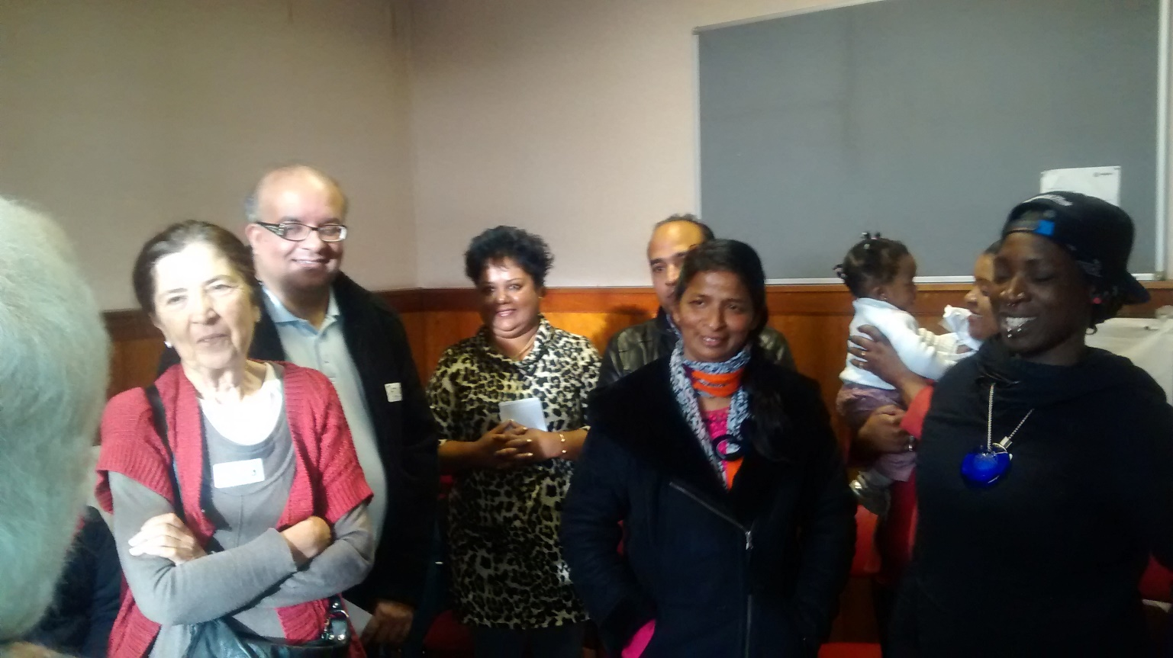
Community Researchers

