Slide 1
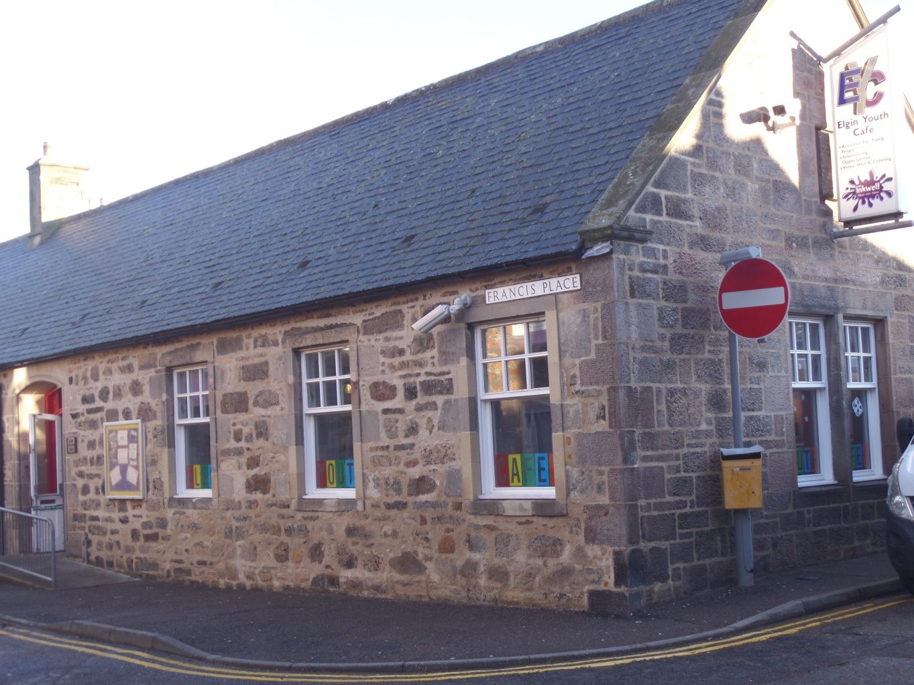
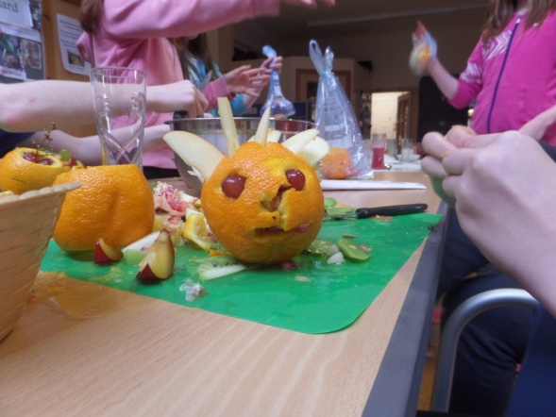
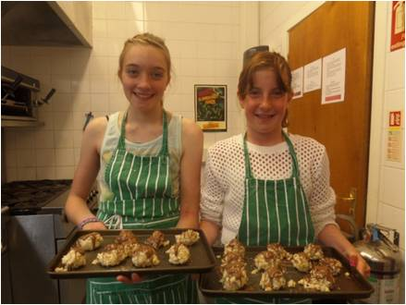
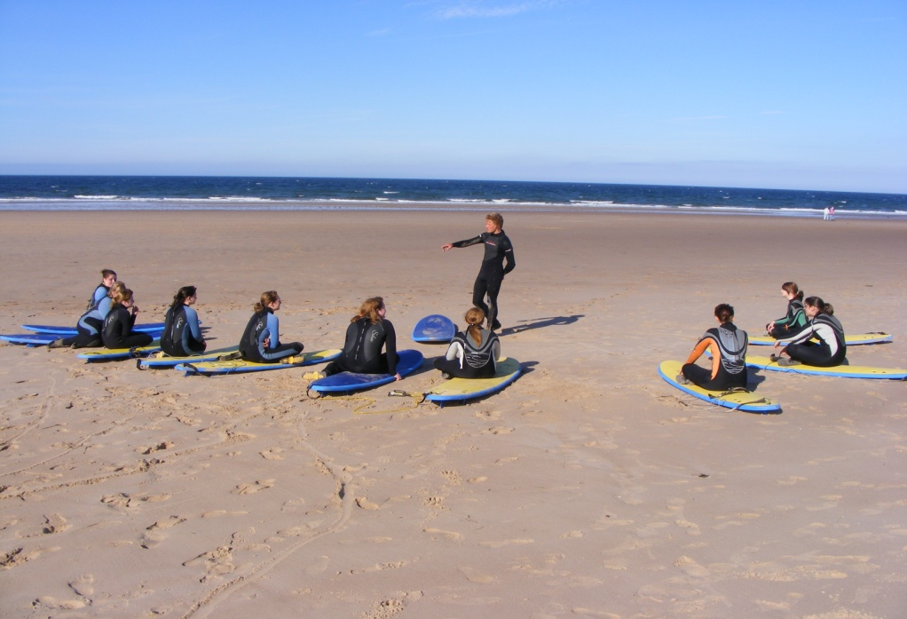

Slide 2
History of EYDG
St Giles & St Columba’s Church funded a Youth Worker with a remit to start a project to offer the young people of Elgin an alterative to roaming the streets.
Elgin Youth Development Group was established in 1998.
Elgin Youth Café was opened in March 2001.
For our 10th anniversary, the Café was completely refurbished in early 2011 at a cost of £75,000.
Inkwell was successfully obtained through Community Asset Transfer in 2014.

Slide 3
Mission Statement
Our mission is to provide a safe and inspiring setting for young people to meet, socialise and learn away from the pressures of modern life. We provide projects and activities that meet young peoples’ needs and support them to reach their potential. To achieve this, we strive to provide facilities that will benefit the whole community, while promoting equality, respect, diversity, independence and responsibility

Slide 4
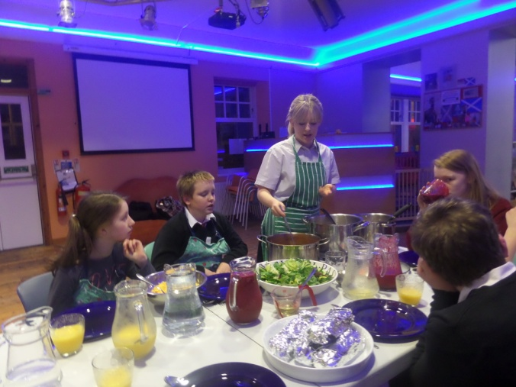
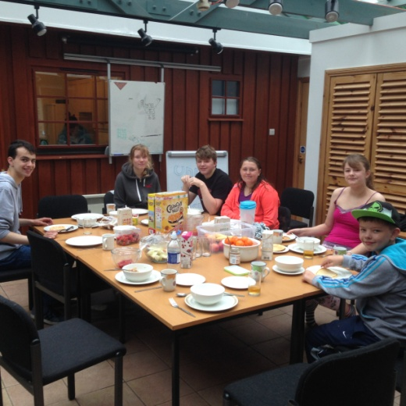
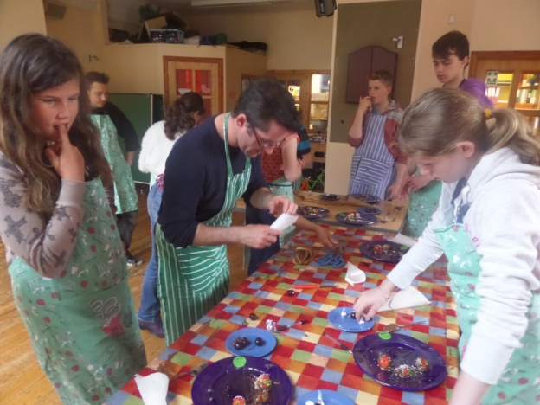
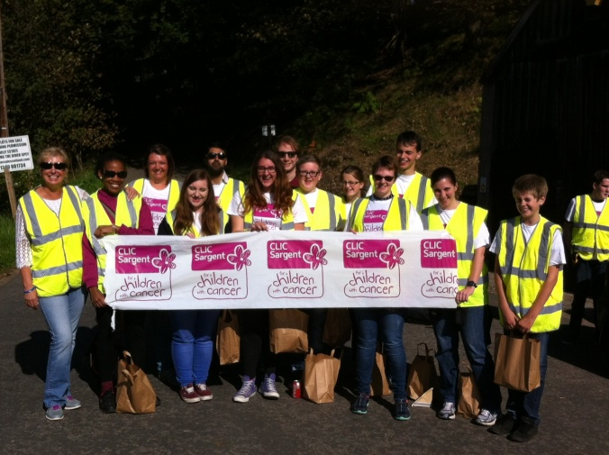
Youth Activities
After School Clubs
Evening Sessions
Holiday Programmes
Theme Nights
Delta Force
1 to 1 support

Slide 6
EYC
Run for the Young People by the Young People - Operational Management Team
Paid
REHIS Elementary Food Hygiene
First Aid
Basic Cooking Skills

Slide 7
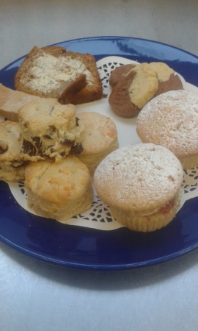
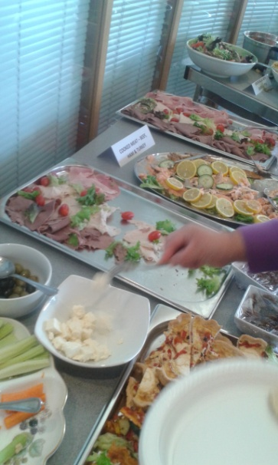
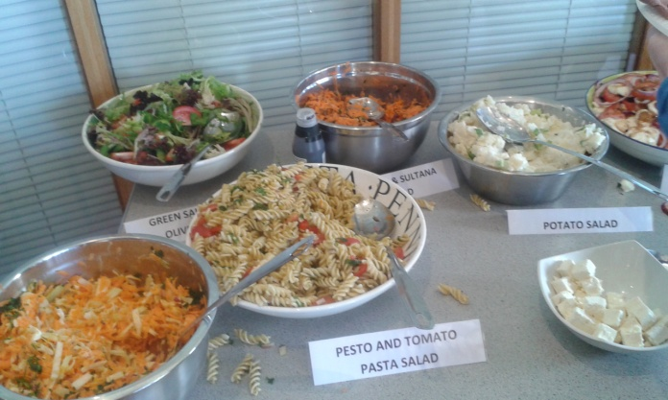
Social Enterprise
Funding Youth Activities through hire of Meeting Rooms and catering provision:
Tea/Coffee
Home Baking
Homemade Soups
Homemade Sandwiches
Buffets

Slide 8
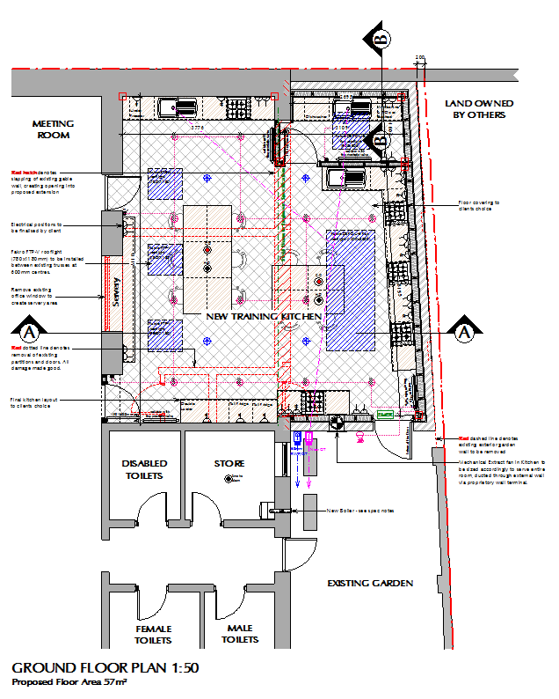
Moving Forward

Slide 9
Thank You Any Questions?

