Slide 1
NHSGGC Cooking course Lizzy Hammond Health Improvement Senior (Nutrition) NHS Greater Glasgow & Clyde

Slide 2
NHSGGC Cooking course
Background
NHSGGC developed universal 6 week cooking programme for target groups to address main barriers:
No conclusive evidence on impact of cooking programmes but some improvement found in confidence, skills and knowledge
Pregnant women
Overweight and obese
Biggest barriers to eating healthy indentified as time, cost, knowledge and accessibility
Older adults
Early years
Carers
Long Term Conditions e.g. Type 2 Diabetics
Vulnerable communities
Themes of: food planning & purchasing, food preparation and cooking & storage
10 week Learning Disability cooking course

Slide 3
NHSGGC Cooking course
Course Content
6 x 2 hour sessions
Education and cooking element
Content cross referenced to ensure barriers were being addressed in purchasing, planning and cooking/storage.
‘Bolt on’ resources when working with specific target groups
Selection of recipes to cook to allow some flexibility and everyone can taste a selection of meals.
Enough food for tastings and food to be taken home
Recipes provided

Slide 4
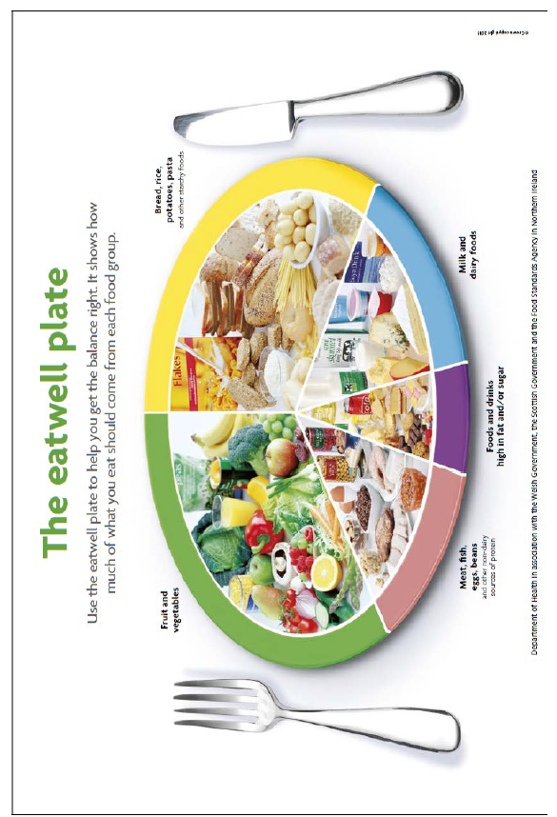
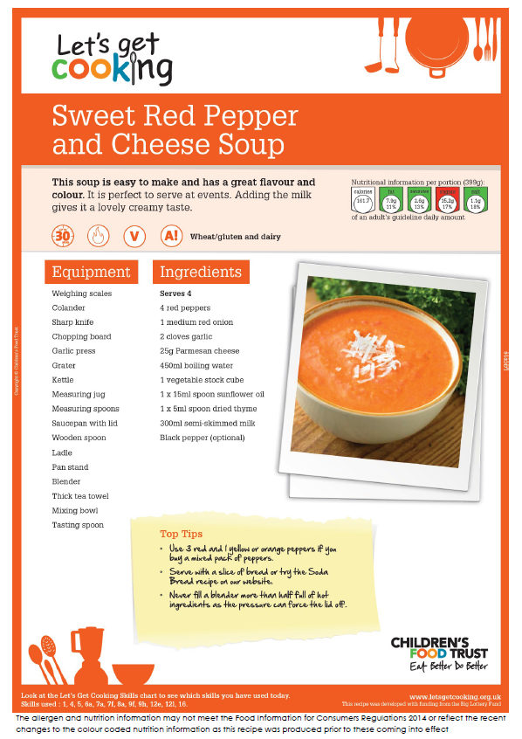
NHSGGC Cooking course
Commissioned existing facilitators to deliver 16 courses
Developed evaluation framework with the University of Glasgow
Supported The Scottish Government Eat Better Feel Better campaign
Developed recipe book from ‘Lets Get Cooking’ recipes and course content
NHSGGC Health Improvement Nutrition Network developing a quality assurance framework
Developed capacity building model for organisations working with target groups

Slide 5
NHSGGC Cooking course
The Future
Reflect on evaluation findings
Develop community cooking facilitator network
Implement the quality assurance framework
Cooking programme
Build capacity and support local organisations working with target groups
Develop clinical pathways

Slide 6
NHSGGC Cooking course
The Challenges
Delivery: Change to a universal model with more limited flexibility
Training: Cooking courses are not just another course
It takes time to get it right
Costs
What works well
Partnership, partnership, partnership!
Communication
Provide ongoing support

Slide 7
NHSGGC Cooking course Thankyou Time for questions

