Slide 1
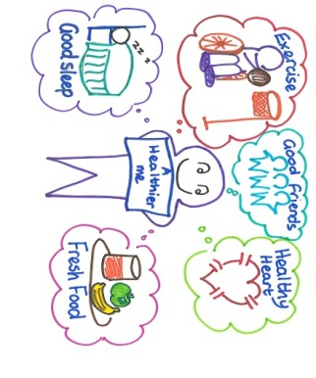
A Healthier Me Project
Fiona Munro
Brothers of Charity Services (Scotland)

Slide 2
The Project
Funded through Scottish Government Health Inequalities Fund
Partnership Project
Scottish Borders Learning Disability Service, NHS Public Health & Brothers of Charity Services (Scotland)
2013 – Pilot Group of 20, 2014 30 new individuals
User led
Big and small groups, Events, Physical health checks, Training/information sessions, Sharing ideas, 1 to 1’s
2015 – Pathway implementation

Slide 3
Health Behaviour Change
Precontemplation
Contemplation
Determination
Action
Maintenance

Slide 4
Community Food and Health Scotland Grant
£656
Applied as evidenced a gap in initial part of year
Ran a “Winter Warmer” event.
Bought kitchen equipment
Cookery demonstration
Ate together
Food basket and recipes to take home
Evaluation

Slide 5
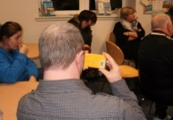
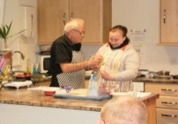
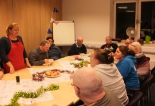
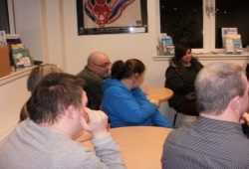
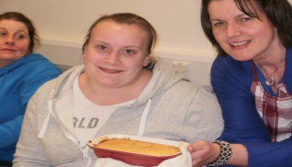
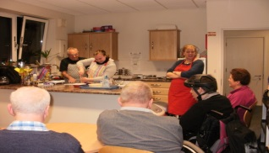
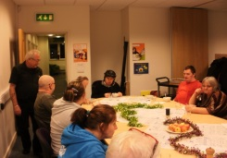
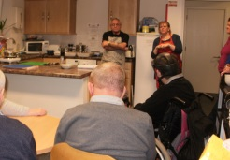
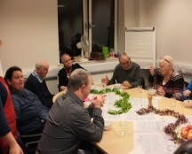
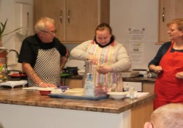
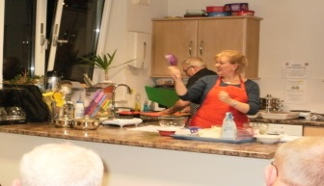
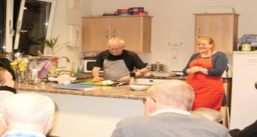
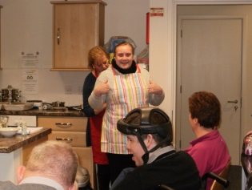
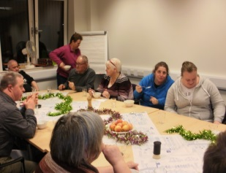
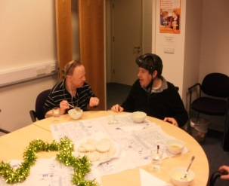
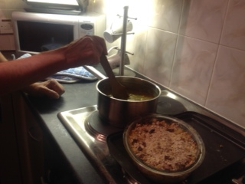
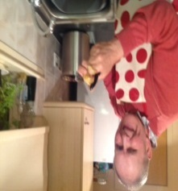
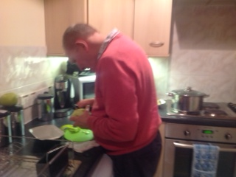
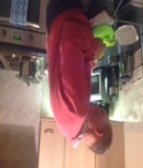
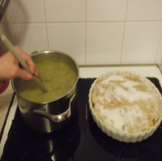
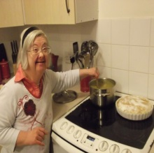
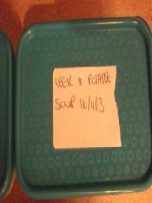
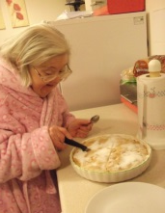
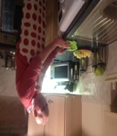
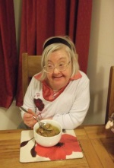
Evidence and Evaluation

Slide 6
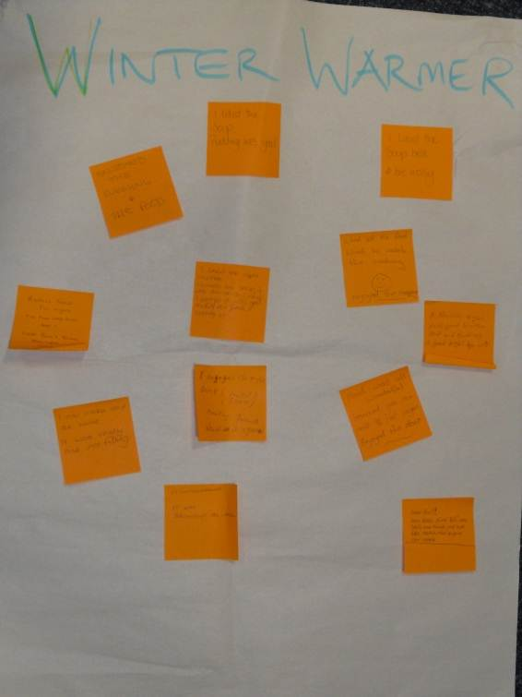
Enjoyed the evening and food
I liked the soup – pudding was good
Really good fun night. The food was brill and I liked F and Y they were good
I can make soup at home. It was really nice and filling.
It was fandabby dozey. It was brilliant as well.
I enjoyed the night. Soup (lentil) was good. Meeting friends. Would do it again.
I liked the apple crumble. I loved the soup – it was delishish. I enjoyed it, was good making new friends and catching up.
I like the soup best. A bit noisey.
Liked all the food. Liked to watch the cooking. Enjoyed the company.
A healthy night with good winter soup and pudding. A good night for all.
Food was wonderful. Learned you can use ½ cal sugar. Enjoyed the demo.
Good fun. Very basic stuff but very tasty and filling, nice and easy meals that anyone can make.

Slide 7
Pathway
How to encourage/involve people in improved lifestyle
Physical health check and lifestyle advice
Programmes of support for individuals
Development and learning – workforce, family and individual
Physical activity
Other sources of support/community signposting

Slide 8
Q and A’s

