Slide 1


Findings from and the evaluation of the NHS Ayrshire and Arran community cooking programme for parents
Dr. Ada Garcia
Human Nutrition

Slide 2
Cooking Programmes in Ayrshire and Arran
Government funding (CEL 36) Community Food Workers delivering cooking skills programmes (2008-2011)
Direct contact with 1500+ parents and carers across 40 Early Years establishments
400 parents attended 1550 hands on sessions – 4 or 6 week programmes (average 4 x 2 hour sessions per person)

Slide 3
Cooking programmes in Ayrshire and Arran
Aims:
Increase awareness of importance of food to good health
Extend skills in shopping, cooking and budgeting
Increase confidence and self-esteem
Activities
Interactive participatory group work
Eatwell plate
Basic cooking skills – or depending on participant needs
Discussion around key nutritional messages: e.g.
Minestrone soup with garlic bread
- stock and understanding salt content on labels
- types of bread, spreading fats
- ready meals: taste and cost comparison
Resources: Cookery book – Munch Crunch 2

Slide 4
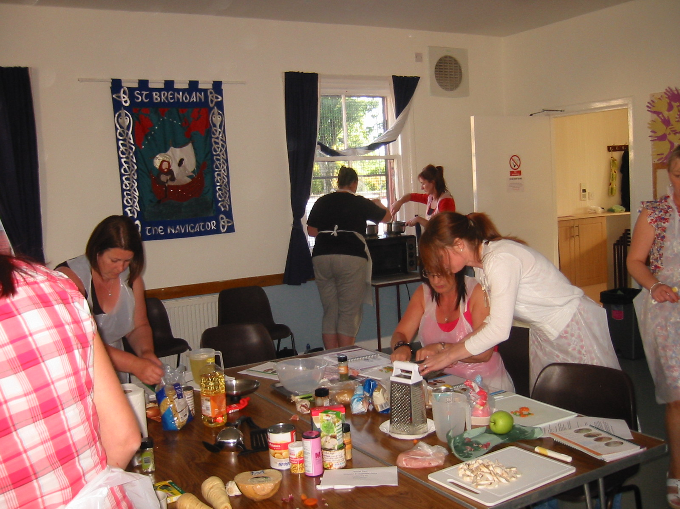

Slide 5
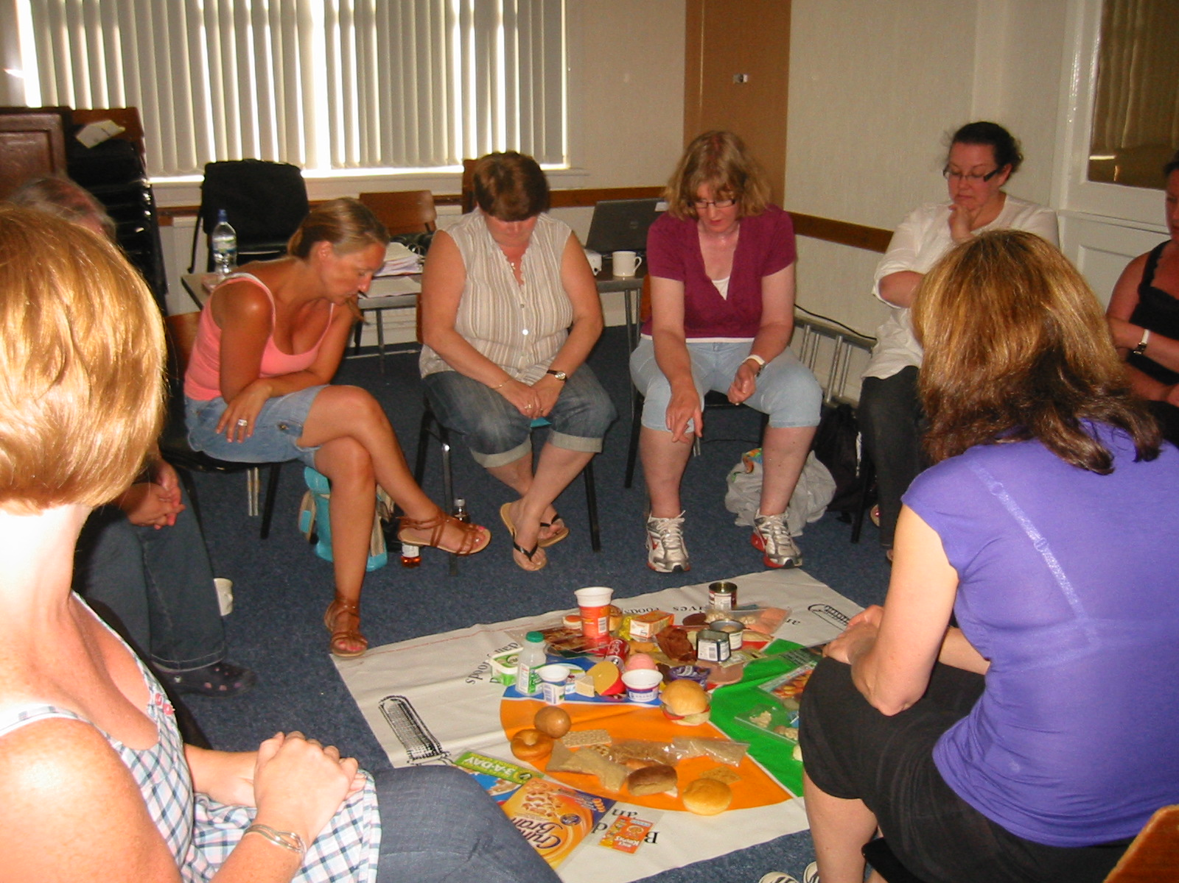

Slide 6
Evaluation of Impact
Evaluation by NHS Health Promotion Officer (baseline and post-intervention)
Questionnaire – shortened version of the tool used in CookWell programme (Barton et al 2011)
Covered confidence, frequency of eating fruit, vegetables and ready meals
At post-intervention: programme enjoyment, self-perception of dietary changes, knowledge
One year on follow-up evaluation by Glasgow University: impact on family eating habits, overall confidence, learn new skills/employability
Garcia AL et al. (2013) Public Health Nutrition

Slide 7
Subjects recruitment and retention
400 total sample
(who took part in all cooking courses)
102 participants with completed questionnaires
(100%)
87 with contact numbers (85.3%)
20 unreachable (19.6%)
18 without working lines (16.6%)
15 without contact numbers (14.7%)
15 baseline & post questionnaires (14.7%)
6 refused to participate
(5.9%)
44 reachable
(43.1%)
44 baseline, post-intervention and follow-up questionnaires
(43.1%)
Baseline and Post Intervention
(written questionnaires)
Follow-up
(questionnaires by telephone interviews)

Slide 8
Characteristics of participants
 | Baseline and post intervention (n=102) | One year follow-up (n=44) | P-value
 | % | %
Female | 97.1 | 100.0
Age |  |  | 1.000
17-24 | 26.2 | 22.7
25-34 | 44.7 | 40.9
35-44 | 25.2 | 29.5
>45 | 2.9 | 6.8
Location |  |  | 0.004
East Ayrshire | 24.3 | 34.1
North Ayrshire | 28.2 | 15.9
South Ayrshire | 46.6 | 50
SIMD |  |  | 0.145
Quintile 1 | 36.9 | 40.9
Quintile 2 | 35.0 | 34.1
Quintile 3 | 8.7 | 6.8
Quintile 4 | 9.7 | 11.4
Quintile 5 | 4.9 | 4.5

Slide 9
Confidence ratings
 | Baseline | Post-Intervention | One year follow up | Δ post-intervention and baseline (p value) | Δ follow up and post-intervention (p value)
Cook from basic ingredients | 5 (2, 7) | 7 (6, 7) | 6 (5, 7) | <0.05 | 0.033
Follow a simple recipe | 5 (5, 7) | 7 (6, 7) | 7 (6, 7) | <0.05 | 0.06
Tasting new foods | 5 (3, 6) | 6 (6, 7) | 5 (5, 7) | <0.05 | 0.002
Preparing and cooking new foods | 5 (4, 6) | 6 (6, 7) | 6 (5, 7) | <0.05 | 0.08
Scale 1 to 7 (from “not at all confident” to “very confident”)
Values are medians (P25,P75)

Slide 10
Patterns of ready-meal, vegetable and fruit consumption
Food consumption patterns | Baseline | Post-Intervention | One year follow up | Δ post-intervention and baseline (p value) | Δ follow up and post-intervention (p value)
How often do you eat ready meals? † | 2-4 times/week | Once/week | Once/week | 0.001 | 0.545
How often do you eat vegetables? ‡ | 5-6 times/week | Once/day | Once/day | 0.028 | 0.177
How often do you eat fruit? § | 5-6 times/week | Once/day | Once/day | <0.05 | 0.170
†Scale, 1=Never, 2=1-3 times a month; 3= once a week; 4=2-4 times a week; 5= 5-6 times a week; 6= Once a day; 7= more than once a day.
‡ Scale, 1= less than once a week; 2= once a week; 3= 2-4 times a week; 4= 5-6 times a week; 5= once a day; 6= twice a day; 7= more than twice a day.
§Scale, 1= less than once a week; 2= once a week; 3= 2-4 times a week; 4= 5-6 times a week; 5= once a day; 6 = 2 or more times a day

Slide 11
Other benefits at one year follow-up
98% of the participants agreed that there were benefits to family members from the cooking skills group.
86% participants agreed that the cooking skills group has improved their overall confidence.
84% participants agreed that the cooking skills course had improved their confidence to learn other skills.
70.4% participants felt more employable after the cooking skills course.

Slide 12
Conclusions from Ayrshire and Arran cooking programme
The Ayrshire & Arran cooking programme suggests that participants benefit from cooking programmes.
Confidence and eating habits improved and some changes were retained after one year.
However, lack of control group, self reported questionnaires, low completion rate.

Slide 13
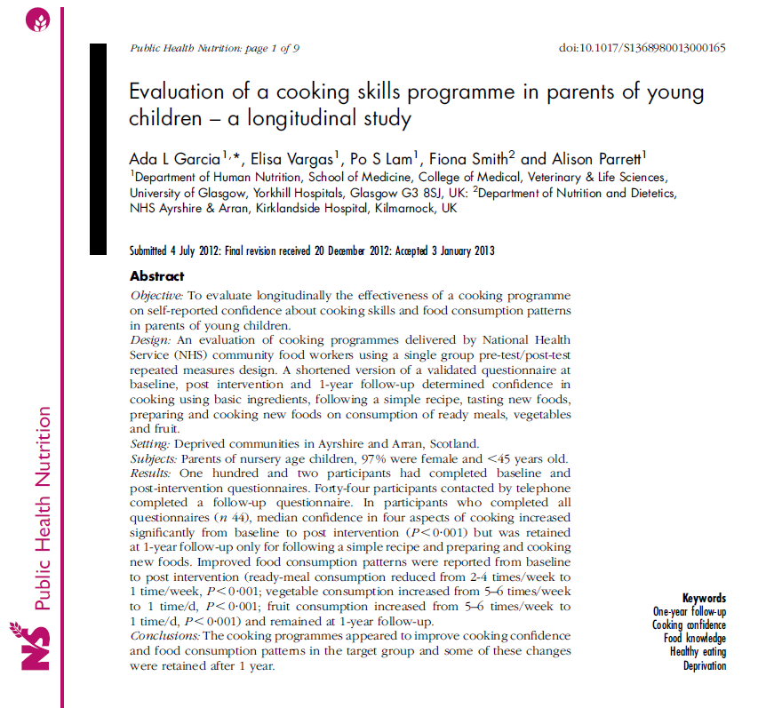
http://journals.cambridge.org/action/displayFulltext?type=6&fid=9218531&jid=PHN&volumeId=17&issueId=05&aid=9218530&bodyId=&membershipNumber=&societyETOCSession=&fulltextType=RA&fileId=S1368980013000165

Slide 14
What has been reported? – evaluations with comparison group designs
Friends with Food ( Kennedy et al. 1998)
The peer‐led Food Club (Moynihan 2006)
The CookWell II Programme (Lawrence et al 2006)
CookWell I Programme (Wrieden et al 2010)
Concerns that the evidence is inconclusive because of the lack of high quality studies Rees R et al. Communities that cook A systematic review of the effectiveness and appropriateness of interventions to introduce adults to home cooking (2012) EPPI-Centre report no. 2004
Recently, a quasi-experimental evaluation of a 10 week Jamie Oliver’s Ministry of Food programme in Australia reported a positive impact of the programme on cooking confidence and eating behaviours for post intervention as well as sustained effects at 6 months (Flego A, PLoS 2014).

Slide 15
Evaluation… take home messages
Confidence, skills and eating behaviours can be modified immediately and some of these can be sustained.
Longer interventions 6-10 weeks work fine
Define clear outcomes (what you want to achieve with cooking programme) and link this with evaluation measurements, fewer outcomes easier to evaluate
Use short concise evaluation forms
Test forms before/preferable use validated forms
Baseline and post intervention imperative!

Slide 16
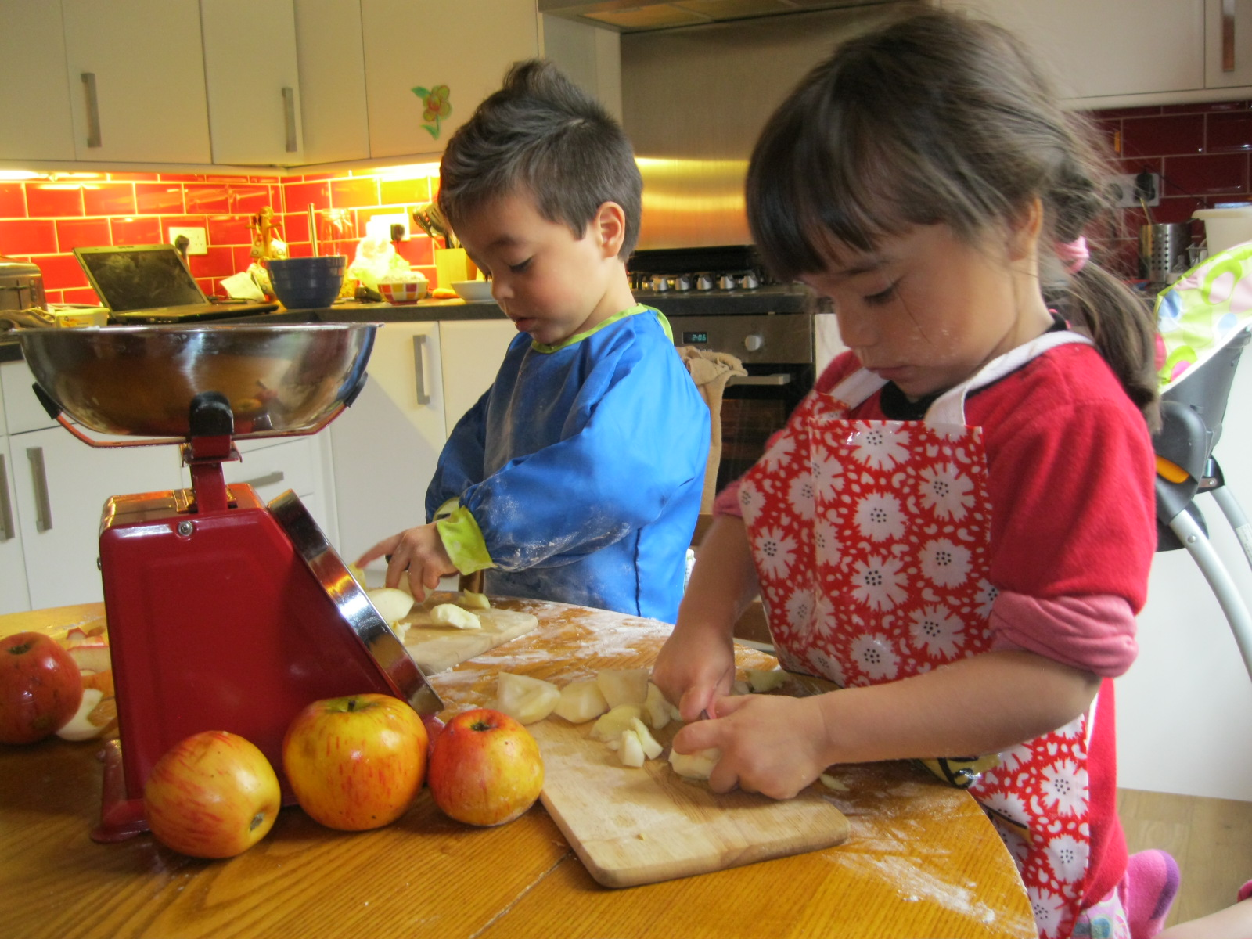
Thanks for your attention!

